Slide 1



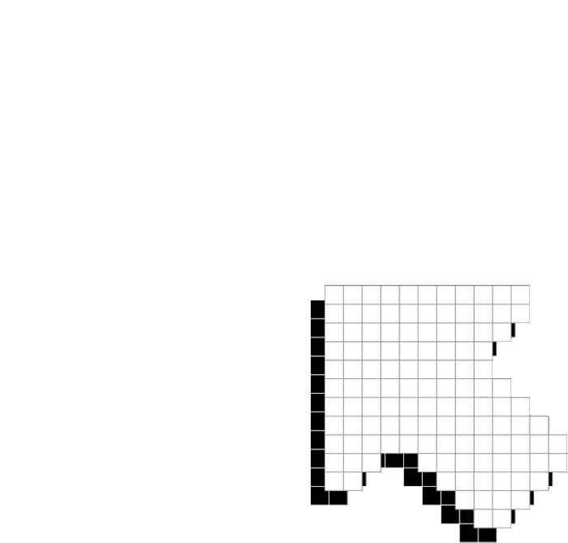


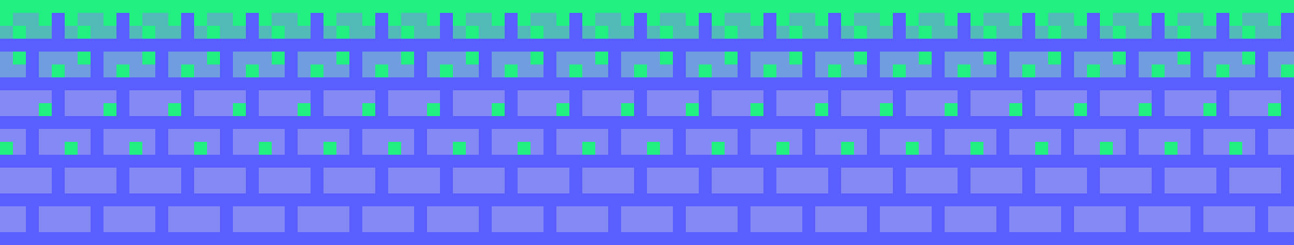
WEB PROJECT-3
MARVEL Fifteen Puzzle
Presented by :
Srija Chitikesi
Krishna Sai Gandi
Shreya Tadipaneni

Slide 2
The objective of the 15 Puzzle is to arrange the numbered tiles in ascending order in a 4x4 grid by sliding them into the empty space. The challenge lies in using the available moves to reorder the tiles and achieve the sequential arrangement, testing spatial reasoning and problem-solving skills. The game offers an entertaining and engaging way to explore permutation and combination strategies within a confined space.
OBJECTIVE

Slide 3




demo
LETS GO TO THE CODE

Slide 4
The 15 Puzzle poses a challenge in rearranging a 4x4 grid of numbered tiles from an initial random arrangement to a sequential order from 1 to 15, with one empty space. The problem involves sliding tiles into the empty space, aiming to achieve the sequential order through a series of moves. The objective is to find an efficient solution to rearrange the tiles using the minimal number of moves and to explore algorithmic approaches that optimize the solving process of this classic puzzle.
PROBLEM STATEMENT

Slide 5




TECHNICAL SKILLS
java script
html
css

Slide 6
Tile Movement
Initial Configuration
STEPS TO PLAY GAME
Objective
Solving Process
moves
Constraint

Slide 7
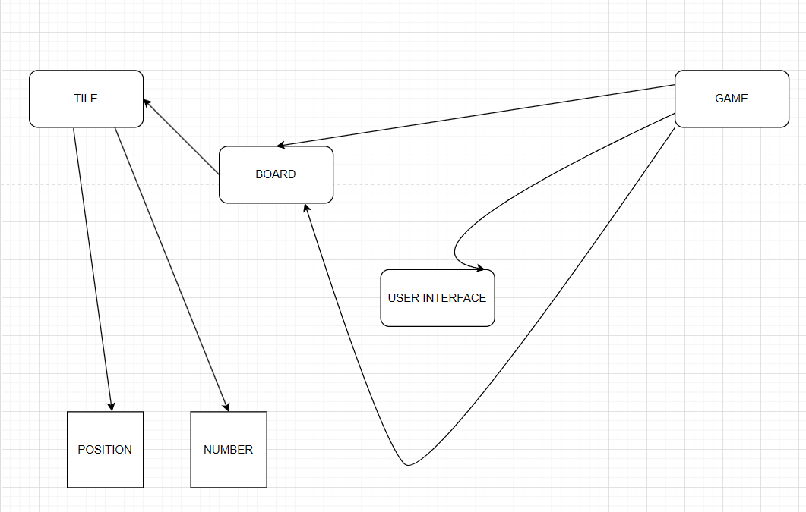
UML

Slide 8
- End-of-game notification
- MULTIPLE BACKGROUNDS
-- Ability to slide multiple squares at once
FEATURES ADDED
- GAME TIME WITH SOME MUSIC FILE
- CHEAT BUTTON
- ANIMATIONS AND/OR TRANSITIONS:

Slide 9
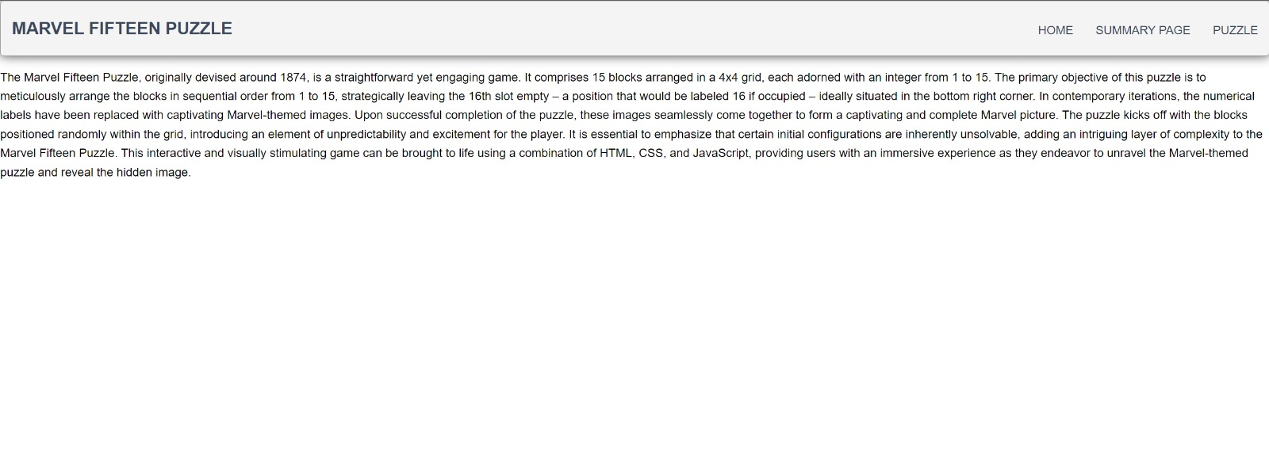
HOME PAGE

Slide 10
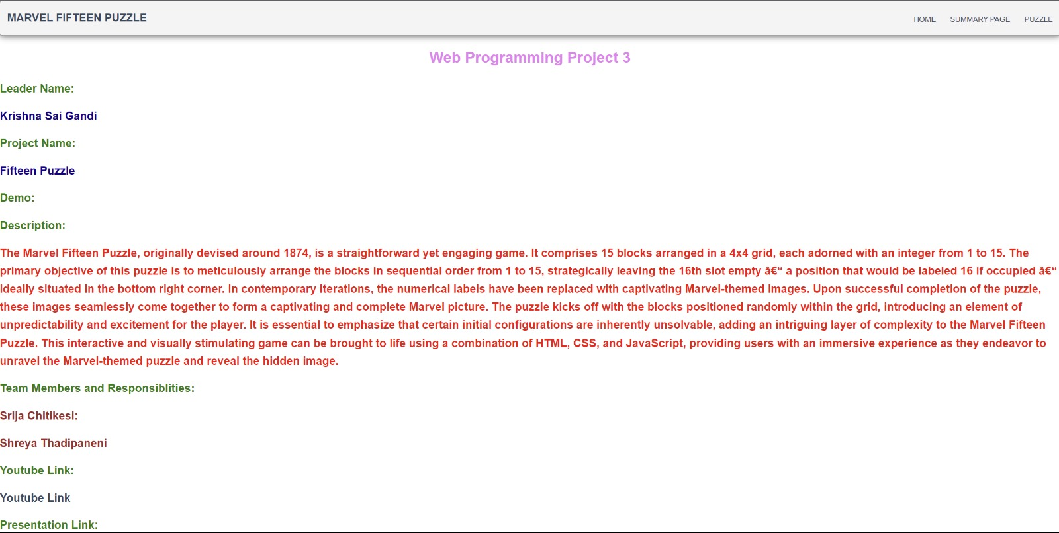
SUMMARY PAGE

Slide 11
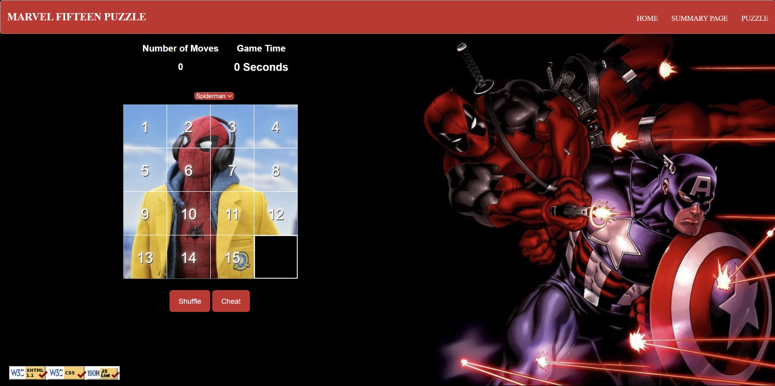
PUZZLE PAGE

Slide 12
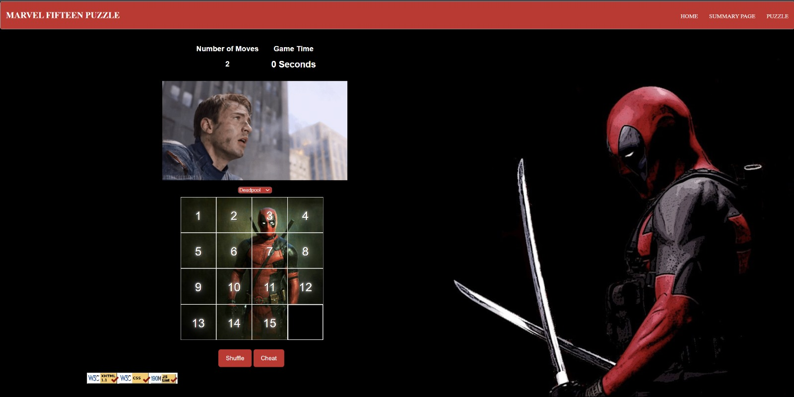
ON SUCCESS

Slide 13
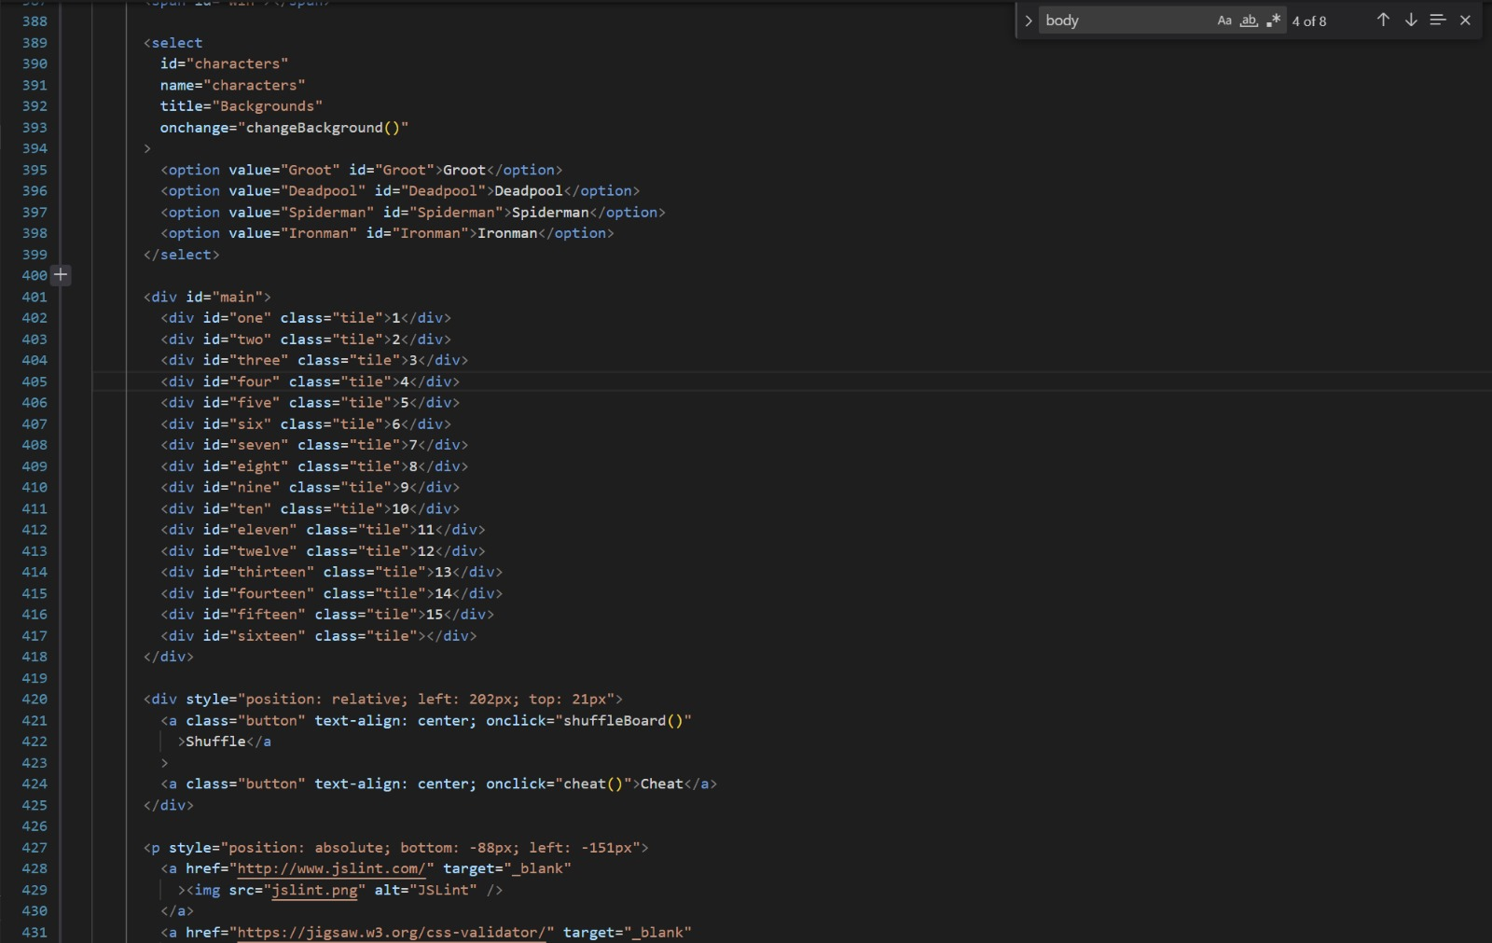
GAME PAGE CODE

Slide 14
CHROME
INTERNET EXPLORER
EDGE
TESTING
SAFARI
CHROME

Slide 15
YOUTUBE- https://youtu.be/YfL0vbAWSE8
GITHUB- tadipaneni/webproject3 (github.com)
LINKS
CODD-https://codd.cs.gsu.edu/~stadipaneni1/web_programming/pw/3/summary.html
https://codd.cs.gsu.edu/~stadipaneni1/Web_Programming/PW/3/index.html

Slide 16
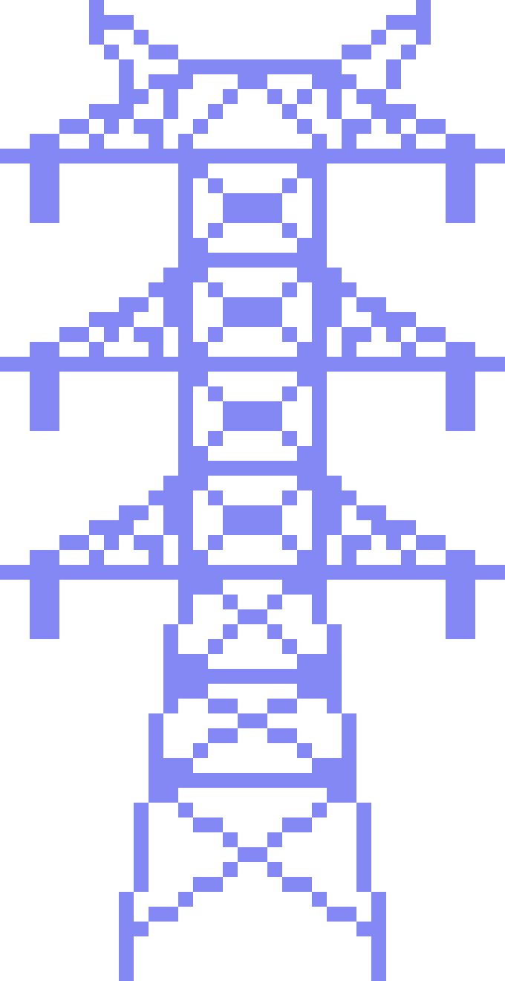



THANK YOU!

